Slide 1

Welcome
Reading
After Phonics
Workshop
Mrs Grace
Miss Bye
Notes:
Welcome to our first Parent’s Information Meeting of the year which will explain our approach to teaching reading after Phonics.
Pupils who struggle to read, struggle in all subjects and the wonders of a knowledge-rich curriculum passes them by unread. Fluency of reading is also a key indicator for future success in further education, higher education and employment.
Once pupils are fluent reading the focus is on comprehension. In KS2, every pupil has a 30 minute reading lesson every day and pupils will then be reading a book matched to their The Zone of Proximal Development (ZPD). ZPD defines the readability range within which pupils should read to best develop their reading, while avoiding frustration. Every child has a ZPD score and books in our library are clearly labelled with the ZPD scores. The children are allowed to choose a reading book that lies within their ZPD. They can change their book after they have taken a quick quiz on the Ipad in class to show how much they have understood. If for any reason, your child does not have a reading book, please inform their class teacher. We will explain further during this presentation and hope that afterwards you will understand the part you can play in helping us to teach your child to read with confidence.

Slide 2

Our approach to teaching reading after phonics
Once pupils are fluent readers, the focus is on comprehension.
In KS2, every pupil has a 30 minute reading lesson every day and pupils will then be reading a book matched to their The Zone of Proximal Development (ZPD). ZPD defines the readability range within which pupils should read to best develop their reading, while avoiding frustration.
From Y2-Y6, children study a class text in school and they read an individual reading book which they bring home.
We will explain further during this presentation and hope that afterwards you will understand the part you can play in helping us to teach your child to read with confidence.

Slide 3
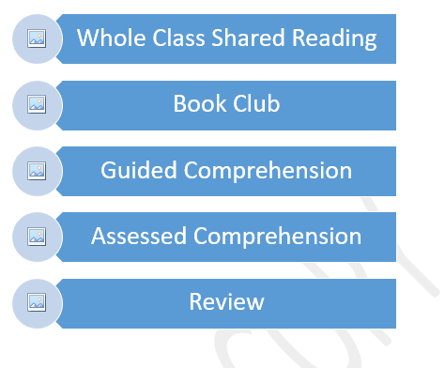
Master Readers: Weekly Overview
Notes:
The weekly cycle supports pupils in developing their reading ability across the week. Pupils have a 30 minute lesson to give them a daily opportunity to become true readers.

Slide 4
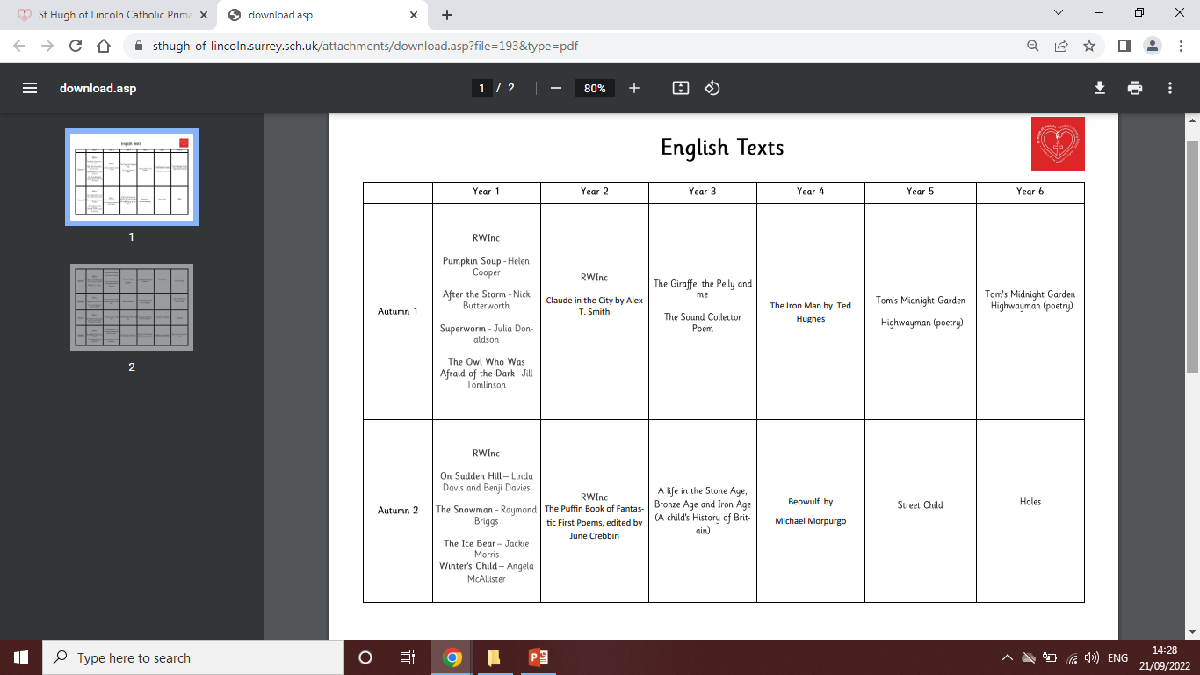
Notes:
The full overview can be found on the school website at the bottom of the English Curriculum page.

Slide 5
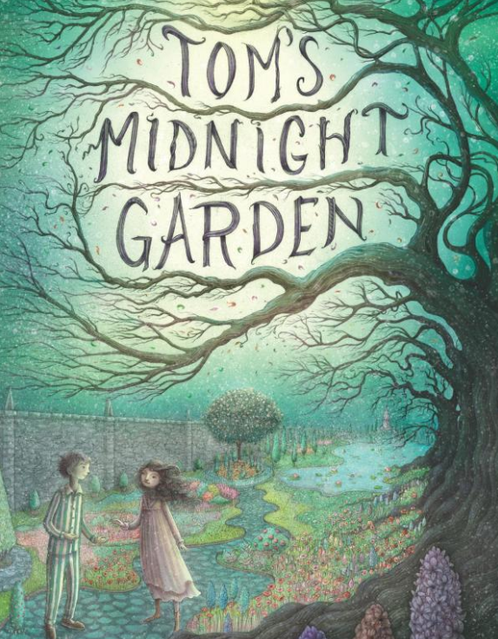
Whole Class Text - Day 1
We study the same chapter for the whole week.
When starting a new book, we talk pupils through the front cover, back cover and read the blurb with them. We use this information to predict the plot and what the main events in the book will be.
We ask questions such as:
What emotions does the cover elicit?
What type of story do you think you will be reading?
Then teacher reads modelling fluent reading of the chapter.

Slide 6
Day 2
1. Predict what might happen
2. Ask questions to improve understanding
3. Explain the meaning of words in context
4. Summarise main ideas
Notes:
These four reading strategies help to develop comprehension. We introduce each strategy one by one starting in Year 2

Slide 7
Day 3
Guided Comprehension
Reading strategies are taken from the National Curriculum:
Predict, Retrieve, Infer, Vocabulary
The whole class works through questions about the chapter we have read one at a time.
Teacher will model how to answer them.

Slide 8
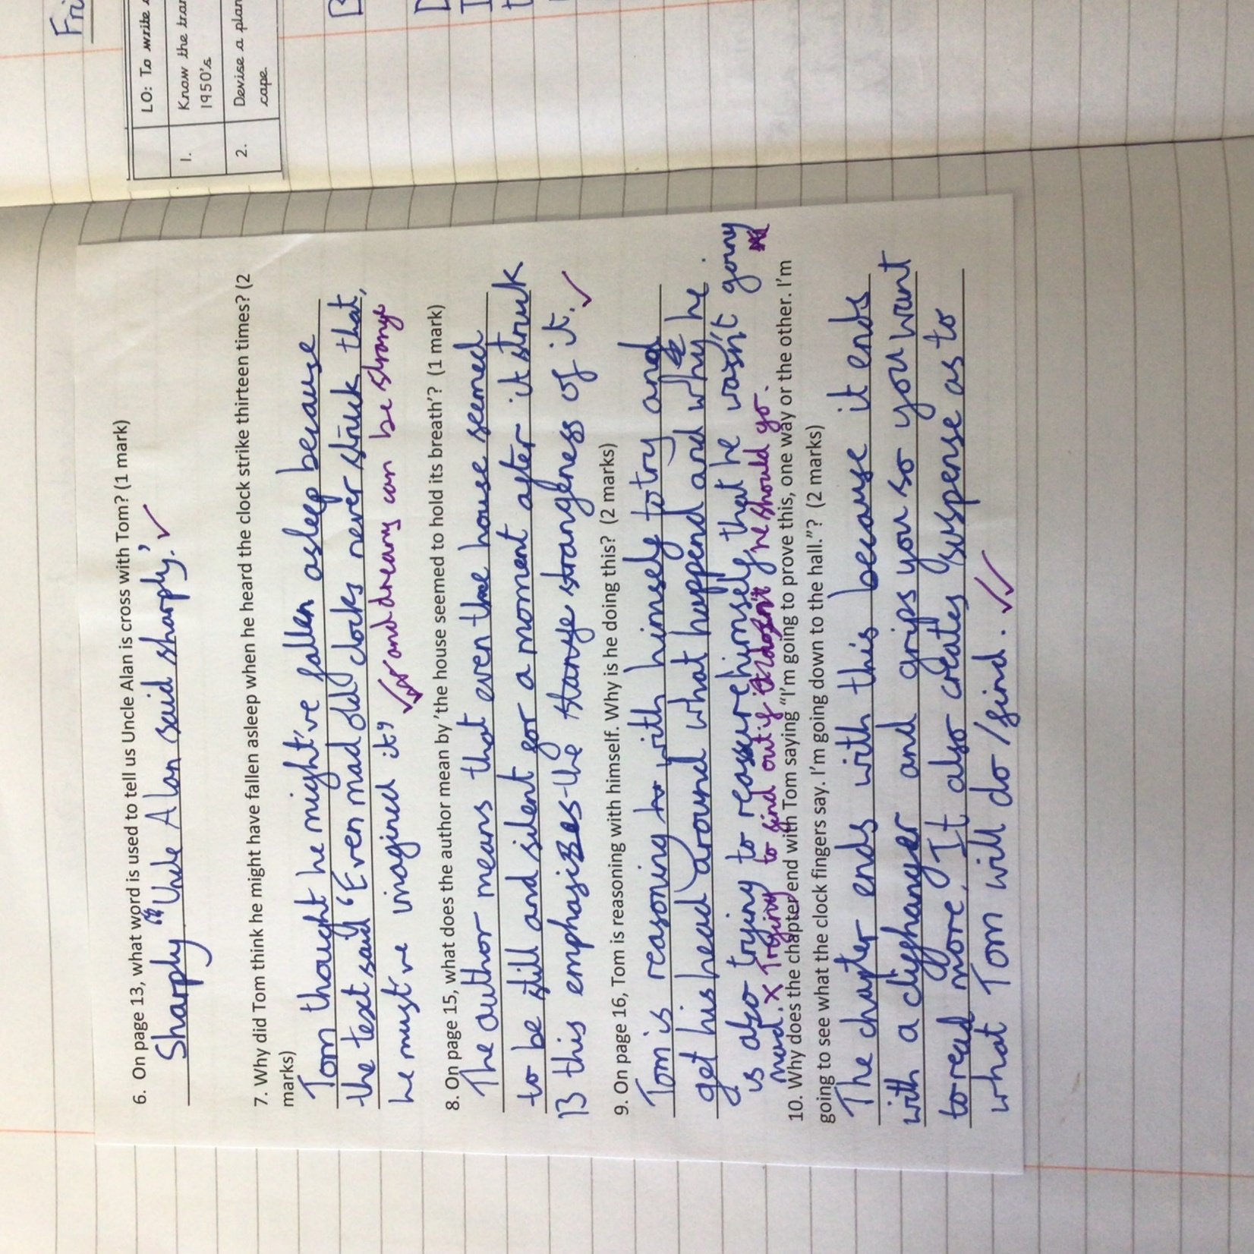
Day 4
Assessed Comprehension
The children become more independent and can now show what they can do writing their own answer in their books. Teacher then models the answer. Children add improvements in purple pen.

Slide 9
Day 5
Address misconceptions
Vocabulary based work
Character work
Shared Reading

Slide 10
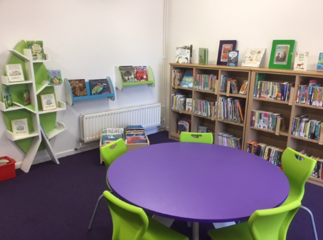
Accelerated Reader
What is accelerated reader?
How does the school determine my child’s reading level?
What is a Star Reader Test?
What is a Zone of Proximal Development (ZPD)?
What are quiz points?
How can I support my child’s progress at home?

Slide 11

What is accelerated reader?
A computer program that helps teachers manage and monitor children's independent reading practice.
Your child picks a book at his/her own level and reads it at his/her own pace.
When finished, they take a short quiz on the computer at school.

Slide 12

How does the school determine my child’s reading level?
A Star Reading test
And
professional judgment based on their knowledge of your child.

Slide 13
What is a Star Reader test?
A reading assessment that uses computer-adaptive technology.
Questions continually adjust to your child's responses.
The test uses multiple-choice questions and takes approximately 20 minutes.
Children are assessed half termly.
Notes:
If the child's response to a question is correct, the difficulty level of the next question is increased. If the child misses a question, the difficulty level of the next question is reduced.

Slide 14
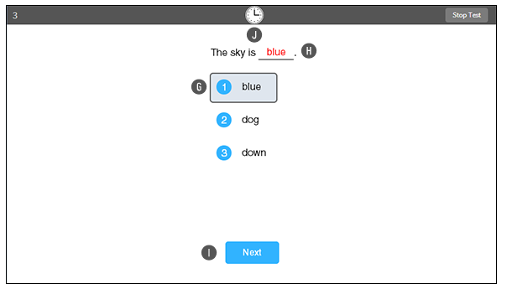
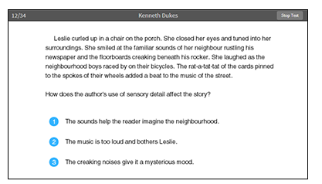
What is a Star Reader test?

Slide 15
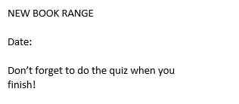
What is a Zone of Proximal Development (ZPD)?
Your child will receive a ZPD range
It is important for children to read with a high degree of comprehension.
ZPD is stuck in their reading diary
1.1 – 1.4
Sept 2022
Notes:
ZPD defines the readability range within which pupils should read to best develop their reading, while avoiding frustration. Every child has a ZPD score and books in our library are clearly labelled with the ZPD scores. The children are allowed to choose a reading book that lies within their ZPD. They can change their book after they have taken a quick quiz on the Ipad in class to show how much they have understood. If for any reason, your child does not have a reading book, please inform their class teacher.

Slide 16
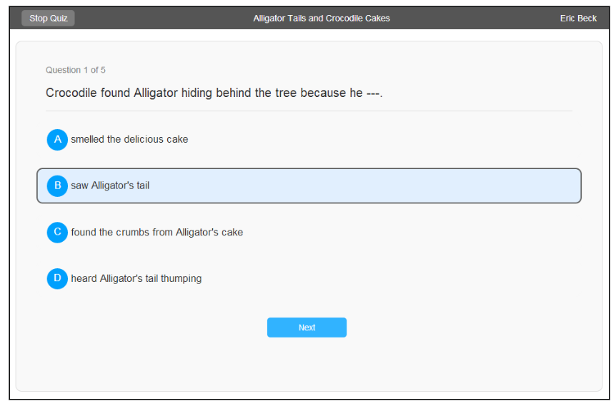
What are quiz points?
Each book is worth a certain number of quiz points
Based on length, vocabulary etc
Get points depending on how many questions they get right
Termly certificates

Slide 17


How can I support my child’s progress at home?
Culture and love of reading at home
Daily reading
Stopping and asking questions
Read yourself and discuss what you read with them
Join the local library

